Slide 1
Graphics with Canvas
Notes:
One of the big changes in HTML5 is the ability to draw graphics natively, without the need for Flash plugins etc. This chapter describes how to achieve this effect using the <canvas> element. The appendices also show an alternative approach using SVG.

Slide 2
Contents
Setting the scene
Getting started with canvas
Using canvas
Demos folder:
Demos\08-Canvas
Notes:
Section 1 explains some essential concepts associated with the <canvas> element in HTML5.
Section 2 shows some simple canvas examples, to help you understand the core programming APIs.
Section 3 dives into the details of the canvas API, and shows how to draw all kinds of graphic shapes.

Slide 3
1. Setting the Scene
Canvas basics
Tools to generate canvas content
SVG basics
Tools to generate SVG content
Canvas vs. SVG
Performance comparison
Notes:
Before the advent of HTML5, you could only use drawing APIs in a browser via plug-ins (e.g. Flash, Vector Markup Language (VML), Silverlight, etc.)
HTML5 provides native graphics support without the need for plug-ins. In fact there are two graphics models in HTML5:
Canvas - see this and next chapter.
Scalable Vector Graphics with Canvas (SVG) - see Appendix D.

Slide 4
Canvas Basics
Canvas enables you to draw onto a bitmap area
Think of it as a dynamic PNG ☺
Immediate mode: "fire and forget"
It doesn't remember what you drew last
It’s up to you to maintain your objects tree
JavaScript APIs and drawing primitives
Simple API: 45 methods, 21 attributes
Rectangles, lines, fills, arcs, Bezier curves, etc.
No DOM support
A canvas is a "black box"
Notes:
The <canvas> element is a blank canvas upon which you can perform drawing operations.
HTML5 defines a bunch of methods you can call to draw various types of shapes, and a bunch of properties you can set to define the ambient colour scheme, pen location, shadow properties, etc.
We'll explore all the details during this and the following chapters.

Slide 5
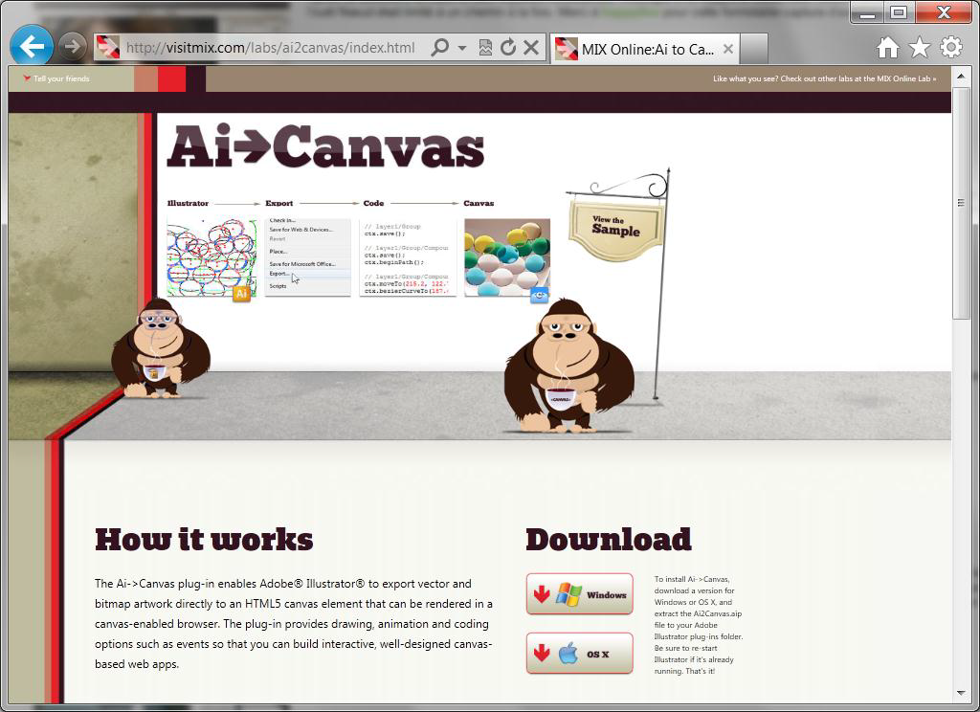
Tools to Generate Canvas Content
Ai->Canvas plug-in
Exports vector and bitmap artwork directly to an HTML5 canvas
Available at http://visitmix.com/labs/ai2canvas/
Notes:
The <canvas> element is very much an HTML5 feature. As such there aren't that many tools on the market to help you generate canvas content.
One tool is Ai->Canvas, as shown in the slide. Other tools are likely to emerge in the fullness of time.

Slide 6
SVG Basics
SVG enables you to draw 2D vector graphics
Using XML elements
Retained mode
The objects tree is kept in memory
SVG XML elements
Elements for a wide range of graphics elements
You can style elements with CSS
Full DOM support
You can access SVG elements through DOM
Notes:
SVG existed as a standard long before the advent of HTML5, as an XML grammar for representing various kinds of shapes.
HTML5 incorporates SVG into the fold. Any SVG elements you add to your document become active nodes in the DOM tree. As such, SVG elements support events and CSS styles, just like any other elements in a Web page.

Slide 7
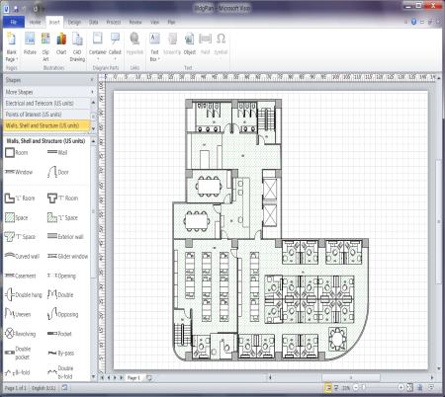
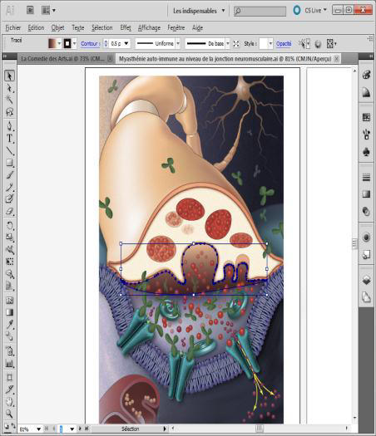
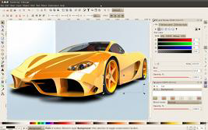
Tools to Generate SVG Content
Microsoft Visio
Export as SVG
Adobe Illustrator
Save as SVG
Inkspace
Free open-source software
Notes:
There is much better tool support for SVG than for <canvas>. This slide lists some of the popular tools for creating SVG content.

Slide 8
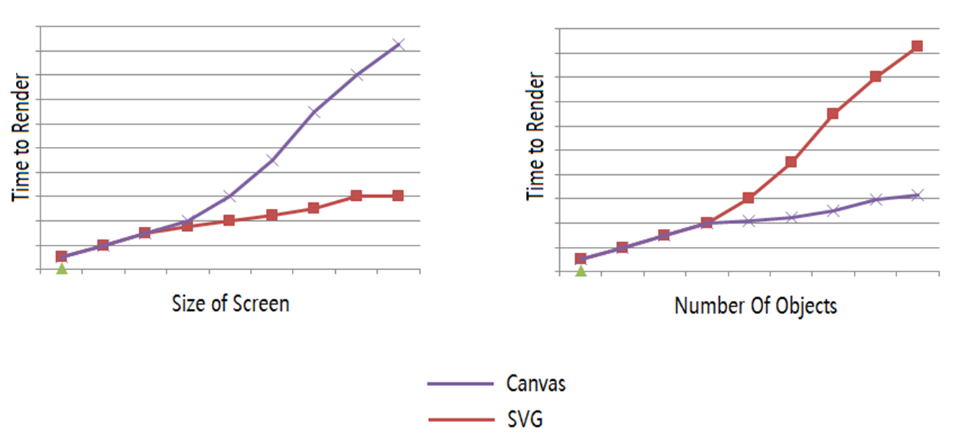
Performance Comparison
Notes:
The canvas API is akin to bitmap graphics, so the larger the canvas, the longer it takes to do the painting. SVG is more like vector graphics, so the size of the drawing area is less significant.
In terms of the number of objects created, canvas performs better than SVG. Each SVG element is a node in the DOM tree, and a complex SVG graphic could be quite onerous. This is significant if you need to repaint the screen frequently, e.g. in animations.

Slide 9
2. Getting Started with Canvas
Creating a canvas element
Using a canvas programmatically
Additional considerations
Checking for canvas support
Notes:
This section takes a closer look at some technical details concerning the <canvas> element, before we look at the detailed API in the next section.

Slide 10
Creating a Canvas Element
A canvas is a rectangular area on a Web page
Default size: 300 pixel wide, 150 pixels high
You can specify an exact size:
You can also specify additional attributes, such as:
Once you've added a <canvas> element to your page, you can use JavaScript to manipulate it any way you want
Add graphics, lines, and text
Draw on it
Add advanced animations to it
<canvas></canvas>
<canvas width="200" height="200"></canvas>
<canvas id="myCanvas" style="border: 1px solid;" width="400" height="600">
Notes:
The <canvas> element lies at the heart of the Canvas API. You'll typically want to set the width and height properties on the <canvas> element, so that it occupies a specified amount of real estate on the screen.
You can also specify other CSS styles as necessary, e.g. a border and drop-shadow.

Slide 11
Using a Canvas Programmatically
To use a canvas, you must get its 2D context
You can then perform actions on the context, and finally apply those actions to the context
You can think of making canvas modifications as similar to using database transactions
You start a transaction…
Perform certain actions…
And then commit the transaction
Canvas coordinate system:
(0, 0)
x
y
Notes:
The <canvas> element has an associated object called a 2D context. Its this object that provides all the methods for drawing shapes and setting colours etc.
When you perform drawing operations, the 2D context remembers ambient settings such as the current pen location, colour scheme, etc. If you want to change these settings temporarily to draw the next shape, you can save the current settings, draw the shape, then restore the original settings.

Slide 12
Additional Considerations
Don't use canvas for simple bits of UI, such as headings
Canvas is overkill, and will slow your page down unnecessarily
Use simple HTML elements instead, e.g. <h1>
Always define fallback content
In case the browser doesn't support the <canvas> element, or a subset of the HTML5 Canvas API features
For example:
Or:
<canvas>
Your browser doesn't support canvas. Time to upgrade :-)
</canvas>
<canvas>
<img src="CanvasNotSupported.jpg" />
</canvas>
Notes:
Canvas operations are quite costly, so you should only use it for genuine graphics. To put it another way, don't use canvas just to draw fancy text!

Slide 13
Checking for Canvas Support
To check whether your browser supports the canvas element:
function testCanvasSupport()
{
try
{
document.createElement("canvas").getContext("2d");
alert("Your browser supports the HTML5 canvas element");
}
catch (e)
{
alert("Your browser doesn't support the HTML5 canvas element");
}
}
Notes:
This slide shows how you can check programmatically whether the current browser supports the canvas API. If it doesn't, there's not much you can do about it (except maybe revert to a Flash animation perhaps).

Slide 14
3. Using Canvas
A simple canvas example
Drawing straight lines
Fine-tuning the output
Drawing curves
Setting color styles
Transformations and animations
Additional demos
Notes:
In this section, we'll step through the most common uses of the HTML5 canvas API. The aim is to explain the important concepts and to see some typical usage.
Full API documentation is available here:
http://www.whatwg.org/specs/web-apps/current-work/multipage/the-canvas-element.html

Slide 15
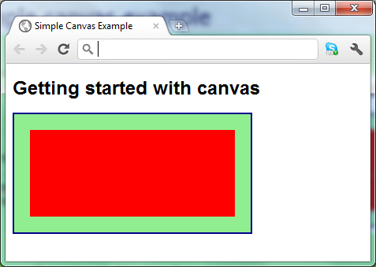
A Simple Canvas Example
Here's a simple canvas example
<style>
canvas {
border: 2px solid darkblue;
background-color: lightgreen;
}
</style>
…
<h1>Getting started with canvas</h1>
<canvas id="myCanvas">
Sorry, your browser doesn't support canvas.
</canvas>
<script>
// Get the canvas element and its drawing context.
var canvas = document.getElementById('myCanvas');
var context = canvas.getContext('2d');
// Draw a simple filled rectangle.
var edge = 20;
context.fillStyle = "red";
context.fillRect(edge, edge, canvas.width - edge*2, canvas.height - edge*2);
</script>
GettingStartedWithCanvas.html
Notes:
This slide shows a simple example of how to use the Canvas API. The comments in the slide describe how it all works, and the screenshot shows the result.
Note the following points in particular:
The fillStyle property on the 2D context allows you to specify the fill style to use for all subsequent drawing operations. In our example, we set the fillStyle to a simple solid color (red), but you can also set colour gradients and images (see later).
The fillRect() method on the 2D context draws a rectangle using the current fill style.

Slide 16
Drawing Straight Lines (1 of 2)
To draw a rectangle:
To draw a path connecting various points:
ctx.fillRect(x1, y1, width, height); // Draw a solid rectangle.
ctx.strokeRect(x1, y1, width, height); // Draw a rectangle outline.
// Start drawing a path.
ctx.beginPath();
// Move to a new point (without drawing a line).
ctx.moveTo(x1, y1);
// Draw lines to new points.
ctx.lineTo(x2, y2);
ctx.lineTo(x3, y3);
…
// Optionally, connect the final point to the first point.
ctx.closePath();
// Stroke the line onto the canvas (i.e. do the rendering).
ctx.stroke();
Notes:
Note the difference between fillRect() and strokeRect():
fillRect() draws a solid (i.e. filled-in) rectangle, using the current fill style specified by the fillStyle property.
strokeRect() draws an outline (i.e. stroked) rectangle, using the current stroke style specified by the strokeStyle property.
You can also draw a path by connecting the dots via the following functions, as illustrated by the lower code box in the slide:
beginPath()
moveTo()
lineTo()
closePath()

Slide 17
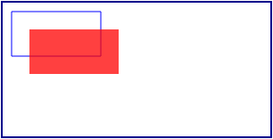
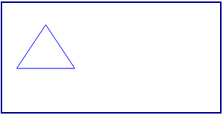
Drawing Straight Lines (2 of 2)
Examples
See StraightLines.html
Rectangles
Paths
Notes:
The example in the slide shows how to draw rectangles (filled and/or stroked) and paths. Open the demo file in a browser to see the effect, then take a look at the HTML code to see how these shapes were drawn on the canvas.

Slide 18
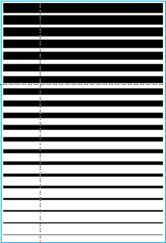
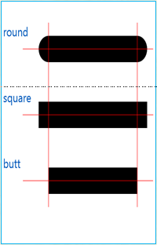
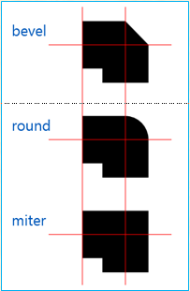

Fine-Tuning the Output
Line width
Line caps
Line joins
Shadows
ctx.lineWidth = width;
ctx.lineCap = 'round' | 'square' | 'butt';
ctx.lineJoin = 'bevel' | 'round' | 'miter';
ctx.shadowOffsetX = horizDistance;
ctx.shadowOffsetY = verticalDistance;
ctx.shadowBlur = amountOfBlurring;
ctx.shadowColor = color;
Notes:
The 2D context object has various properties that allow you to fine-tune the appearance of lines in a canvas drawing. The code snippets and screenshots in the slide show these properties in action.

Slide 19
Drawing Curves (1 of 2)
To draw an arc:
To draw a quadratic curve:
To draw a bezier curve:
ctx.arc(centerX, centerY, radius, startAngle, endAngle, isAntiClockwise);
ctx.arcTo(startX, startY, endX, endY, radius);
ctx.quadraticCurveTo(controlPointX, controlPointY, endX, endY);
ctx.bezierCurveTo(controlPoint1X, controlPoint1Y,
controlPoint2X, controlPoint2Y,
endX, endY);
Notes:
The arc() function allows you to draw an arc centered on a specified location in the canvas drawing area. Note the following points:
A start angle of 0 points horizontally from left to right (it's like a compass needle pointing East).
Angles are expressed in radians, not degrees.
If you specify an end angle of 2*Math.PI, this represents a full circle rather than an arc.
If you've set a fill style, the arc will be drawn as a solid shape rather than as an outline.
The quadraticCurveTo() function draws a curve with one kink (i.e. a curve that represents a quadratic equation). Note the following points:
The curve starts at the current pen position, e.g. as specified by a prior call to moveTo().
The curve ends at the location specified by the endX and endY parameters.
The curvature is governed by the control point specified by the controlPointX and controlPointY parameters. See the example on the next slide for details.
The bezierCurveTo() function is similar, except it represents a cubic equation. It has two control points, which allows the curve to have two kinks. See the example on the next slide for details

Slide 20
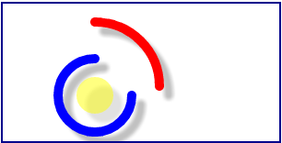
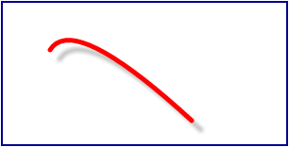
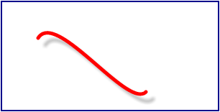
Drawing Curves (2 of 2)
Examples
See Curves.html
Arcs
Quadratic curves
Bezier curves
Notes:
The example in the slide shows how to draw arcs (filled and/or stroked, clockwise or anticlockwise), quadratic curves, and bezier (i.e. cubic) curves. We've drawn a nice shadow on all these shapes too, for effect ☺.

Slide 21
Setting Color Styles (1 of 2)
To set a fill style or a stroke style:
To fill a shape with a gradient:
To fill a shape with a pattern:
ctx.fillStyle = color; // Or cxt.strokeStyle.
ctx.fill(); // Or cxt.stroke().
// Create a linear gradient or a radial gradient.
var grad = ctx.createLinearGradient(startX, startY, endX, endY);
var grad = ctx.createRadialGradient(startCircleX, startCircleY, startCircleRadius,
endCircleX, endCircleY, endCircleRadius);
// Set the colors in a gradient.
grad.addColorStop(fraction1, color1);
grad.addColorStop(fraction2, color2);
…
// Fill a shape with a gradient.
ctx.fillStyle = grad;
var image = document.getElementById("anImageElement");
var pattern = ctx.createPattern(image, "repeat");
ctx.fillStyle = pattern;
Notes:
There are four ways to set a fill style or stroke style for subsequent drawing operations:
A solid colour
A linear gradient, as created via the createLinearGradient() function. You specify the colours along the straight-line gradient by calling addColorStop() numerous times.
A radial gradient, as created via the createRadialGradient() function. You specify the colours for concentric circles about the centre point, by calling addColorStop() numerous times.
An pattern, as created via the createPattern() function.

Slide 22
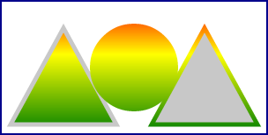
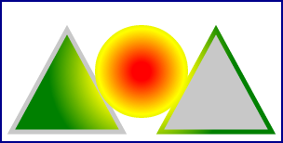

Setting Color Styles (2 of 2)
Examples
See Colours.html
Linear gradients
Radial gradients
Patterns
Notes:
The example in the slide shows how to use linear gradients, radial gradients, and images to fill/stroke some shapes.
The shapes in each part of the example are the same. All that differs is the style that's used to do the drawing.

Slide 23
Transformations
To rotate:
To translate:
To scale:
To adjust the current transformation matrix:
To set a new transformation matrix:
ctx.rotate(clockwiseAngleInRadians);
ctx.translate(deltaX, deltaY);
ctx.scale(xScaleMultiple, yScaleMultiple);
ctx.transform(scaleX, skewX, scaleY, skewY, translateX, translateY);
ctx.setTransform(scaleX, skewX, scaleY, skewY, translateX, translateY);
Notes:
The functions listed in the slide allow you to transform the coordinate system of the 2D context, so that subsequent drawing operations will take place on a rotated/translated/scaled set of axes.
You can also call transform() or setTransform() to combine multiple transformations in a single call:
transform() is cumulative, i.e. it honours any existing transformations that you might have defined on the coordinate system.
setTransform() is not cumulative, i.e. it discards any existing transformations that you might have defined on the coordinate system and starts afresh.

Slide 24
Animations
You can draw animations on a canvas
Define a function that draws on the canvas
Call the function in a timer, to draw a different image each time
Notes:
The Canvas API is often used to create animation effects, like a cartoon. The idea is that you repaint the canvas many times a second, drawing shapes at a slightly different location each time, to give the illusion of movement.
The following slide shows a simple example of how to perform animations.

Slide 25
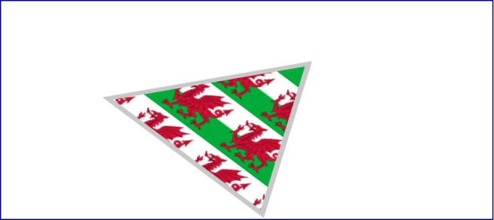
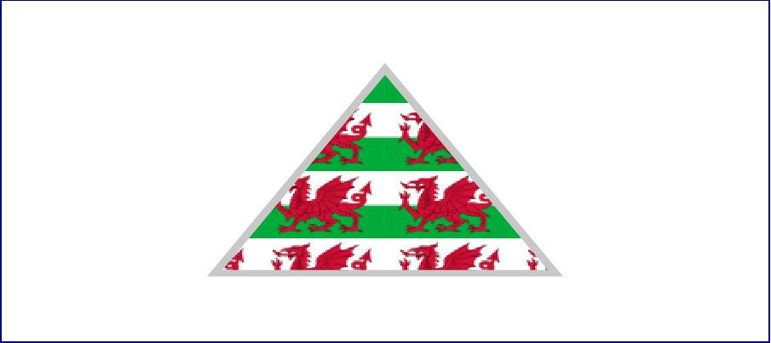
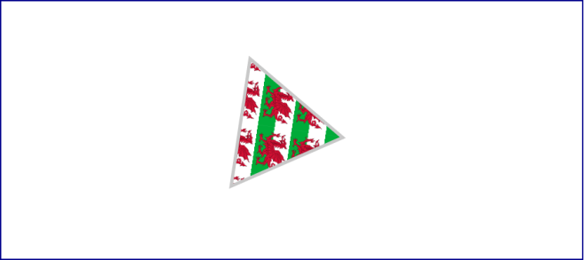
Transformations and Animations Demo
Examples
See TransformationsAndAnimations.html
Separate transformations
Matrix transformation
Animation
Notes:
The example in the slide shows how to perform transformations and animations in a canvas. Take a close look at the code in the demo to see how each part of the example works.

Slide 26
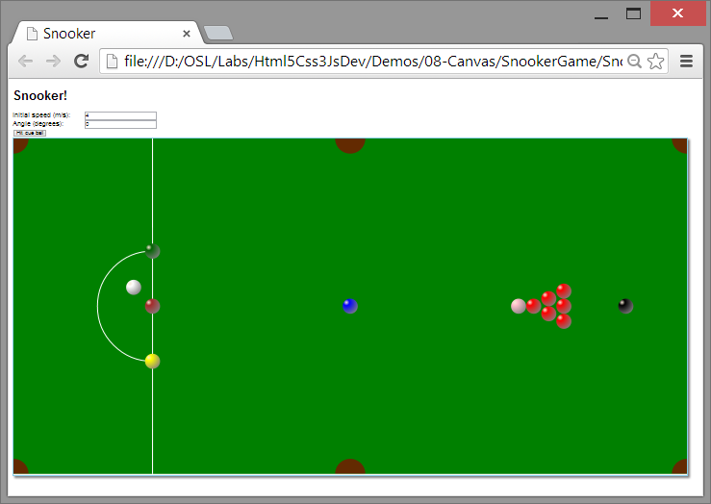
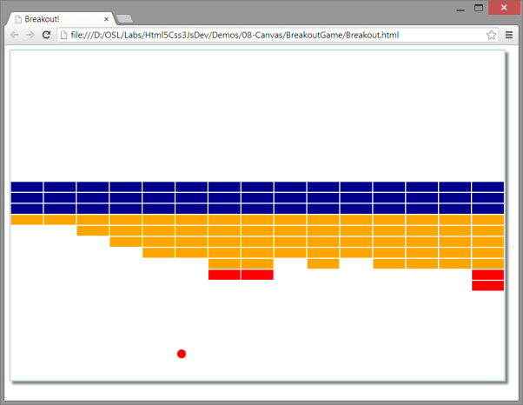
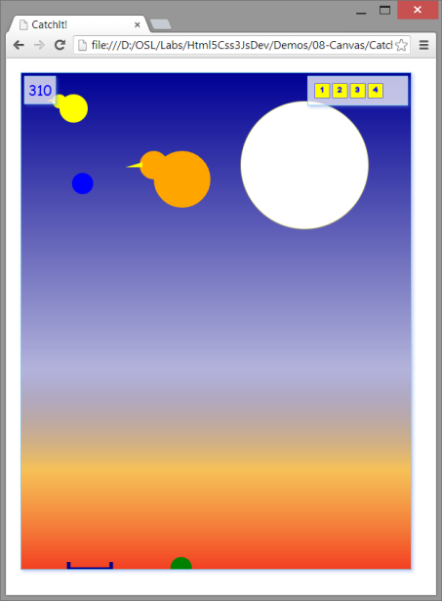
Additional Demos
We've got some additional demos that show what you can achieve using canvas!
SnookerGame
BreakoutGame
CatchitGame
Notes:
To wrap up this chapter, take a look at the examples in the slide. These examples give you an idea of the kinds of effects you can achieve using the Canvas API and an animation loop!

Slide 27
Any Questions?

